Slide 1

ML ASSISTED IMAGE PROCESSING SOFTWARE FOR MEDICINAL PLANTS
This presentation introduces an innovative Python-based software solution that leverages the YOLO (You Only Look Once) algorithm v8 to enable efficient and accurate image processing of medicinal plants. The software aims to revolutionize the field of plant management by providing a powerful, streamlined tool for researchers and practitioners.
AKALYA G (210701021)
ARAVIND S (210701033)

Slide 2
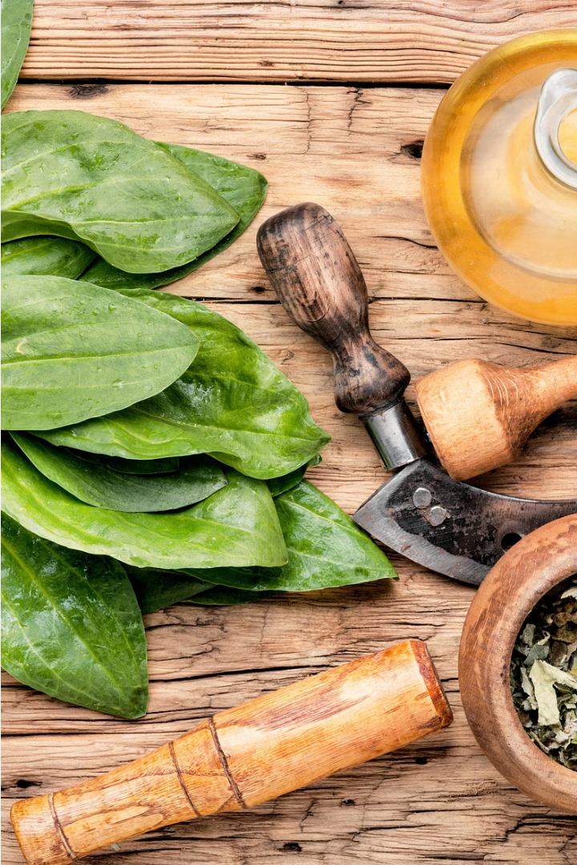
ABSTRACT
This project automates the detection and classification of medicinal plants using the YOLOv8 (You Only Look Once) object detection algorithm. Traditional identification methods are labor-intensive and require expert knowledge, limiting large-scale applications. By fine-tuning the pre-trained YOLOv8 model with a custom dataset of annotated plant images, the system achieves high accuracy in real-time plant identification. The training involves setting up a configuration file (data.yaml) and evaluating the model with a test set. The resulting system provides visual and textual outputs of detected plants, aiding botanical research, conservation, and agriculture by streamlining the identification process.

Slide 3
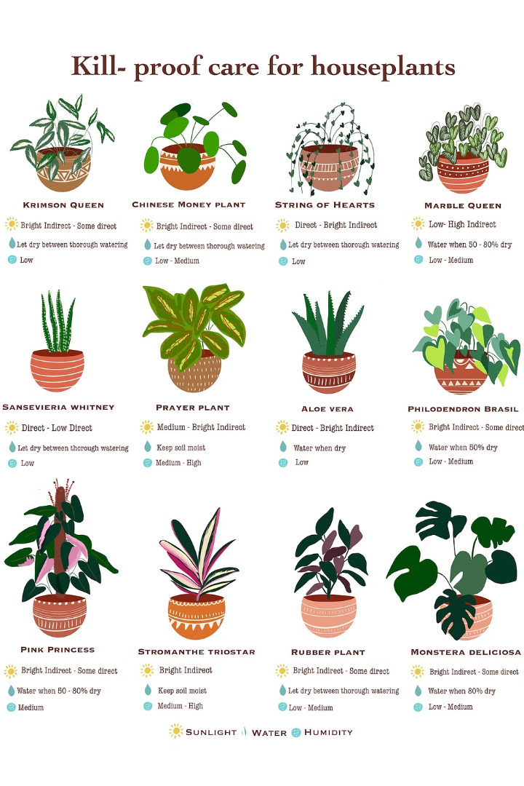
EXISTING SYSTEM
The current approach to identifying medicinal plants typically involves manual observation by botanical experts, aided by field guides and taxonomic keys. This process is labor-intensive, time-consuming, and subjective, leading to inconsistencies in identification results. Expert dependence restricts scalability, while the lack of accessibility to botanical expertise limits the applicability of traditional methods. Moreover, manual processes are prone to errors, especially in large-scale surveys or remote regions. As a result, there is a growing need for automated systems to improve the efficiency and accuracy of medicinal plant identification, addressing the limitations of traditional methods and facilitating broader access to plant identification capabilities.

Slide 4
PROPOSED SYSTEM
The proposed system leverages the power of the YOLO (You Only Look Once) algorithm v8 to revolutionize the way medicinal plants are identified, classified, and monitored. By harnessing advanced machine learning and computer vision techniques, this innovative software solution offers a streamlined and highly accurate approach to plant management.
Automated Plant Identification: The system can rapidly and precisely identify a wide variety of medicinal plant species, reducing the reliance on manual, error-prone methods.
Intelligent Classification: The software categorizes medicinal plants based on their unique visual characteristics, enabling researchers and practitioners to efficiently manage and track different plant varieties.
Real-time Monitoring: The system can continuously monitor medicinal plant populations, providing valuable insights into growth patterns, health status, and environmental factors that influence their well-being.

Slide 5
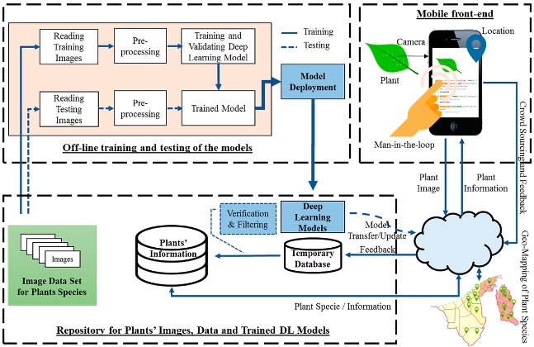
ARCHITECTURE DIAGRAM

Slide 6
MODULES DESCRIPTION
Dataset Collection and Annotation Module:
Model Training and Optimization Module:
This module focuses on acquiring a diverse set of annotated medicinal plant images. Through Data Sourcing, images will be gathered from botanical gardens, online repositories, and herbarium collections. Data Annotation will involve manual annotation by experts, marking bounding boxes around plant instances and assigning class labels.
Here, the YOLOv8 model will be fine-tuned for medicinal plant detection. Model Architecture Selection will determine the best YOLOv8 variant. Transfer Learning will utilize pre-trained weights for faster training, while Hyperparameter Optimization will optimize parameters for accuracy and efficiency.
System Development Module:
Evaluation and Deployment Module:
This module aims to create an intuitive system for dataset management and model training. User Interface Design will craft an easy-to-use interface for image uploading and annotation. Backend Development will ensure robustness in data storage and model training pipelines. Result Visualization will provide tools for analyzing detection results.
Before deployment, the model's performance will be thoroughly evaluated. Performance Evaluation will assess metrics like accuracy and precision. Cross-Validation will ensure the model's generalization across different conditions. Deployment will integrate the model into existing systems for practical use.

Slide 7
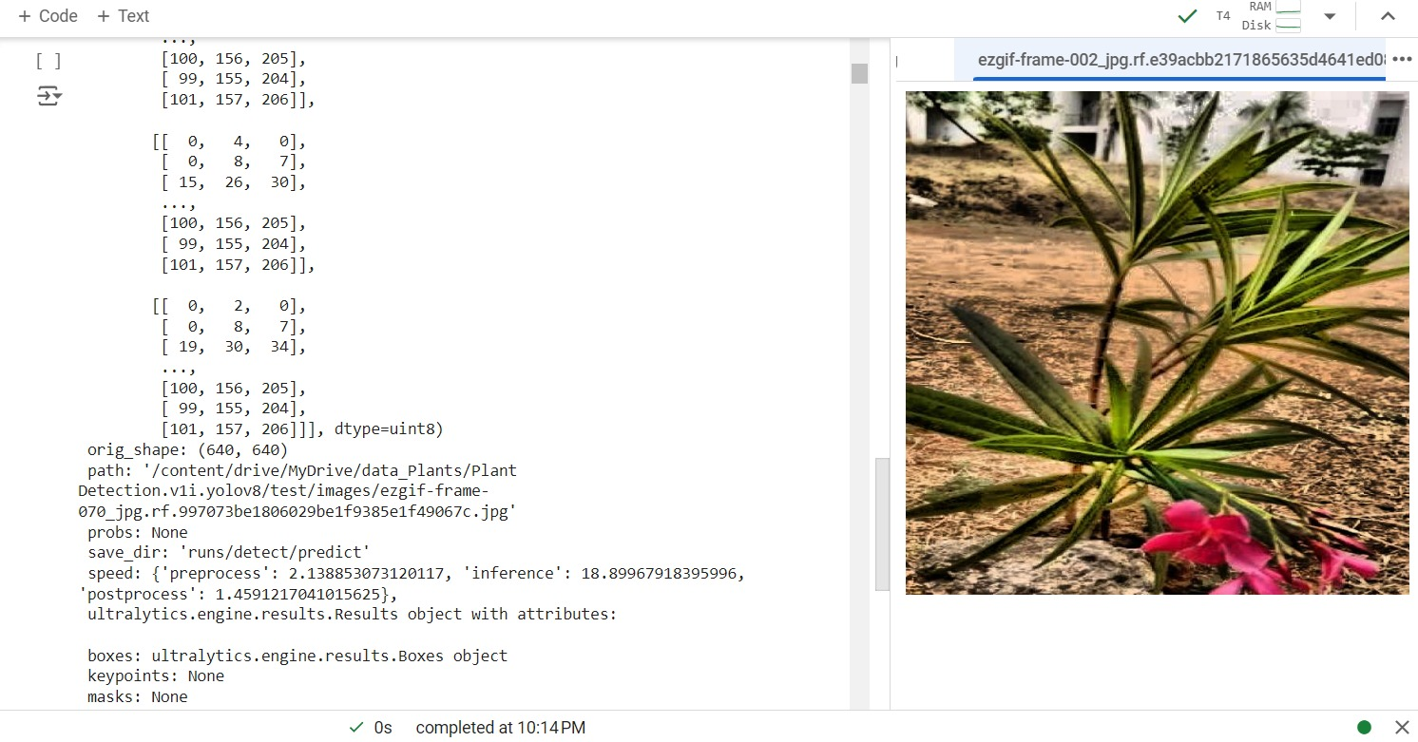
OUTPUT
Accurate Identification
The advanced machine learning algorithms accurately identify and classify a wide range of medicinal plant species, empowering practitioners to effectively manage their collections.

Slide 8
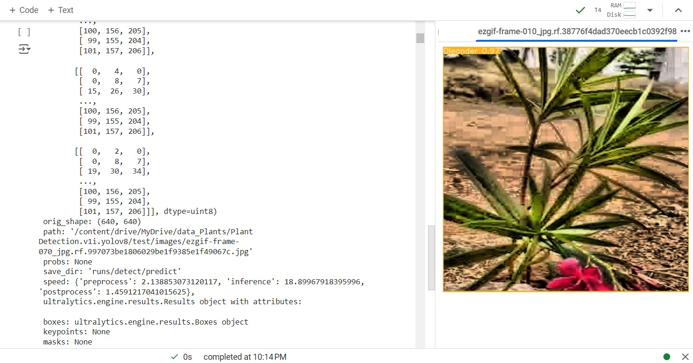
Identification of Species
The trained model output image displays bounding boxes around detected medicinal plant instances, accompanied by class labels identifying the plant species. This output provides a visual representation of the model's successful identification and localization of medicinal plants.

Slide 9
CONCLUSION
Transformative Impact
Expanding Possibilities
The ML-assisted image processing software for medicinal plants has the potential to revolutionize the field, empowering researchers and practitioners to manage and optimize their plant collections with unprecedented efficiency and accuracy.
By seamlessly integrating the advanced YOLO v8 algorithm, this innovative solution paves the way for continued advancements in plant identification, classification, and monitoring, unlocking new frontiers in medicinal plant research and cultivation.
Sustainable Future
Collaborative Approach
The software's focus on real-time monitoring and environmental analysis supports sustainable practices, ensuring the long-term viability and responsible management of medicinal plant resources for future generations.
The software's collaborative features foster a shared knowledge base and best practices, enabling researchers and practitioners to work together in advancing the field of medicinal plant management and harnessing the full potential of this powerful technology.

